Slide 1
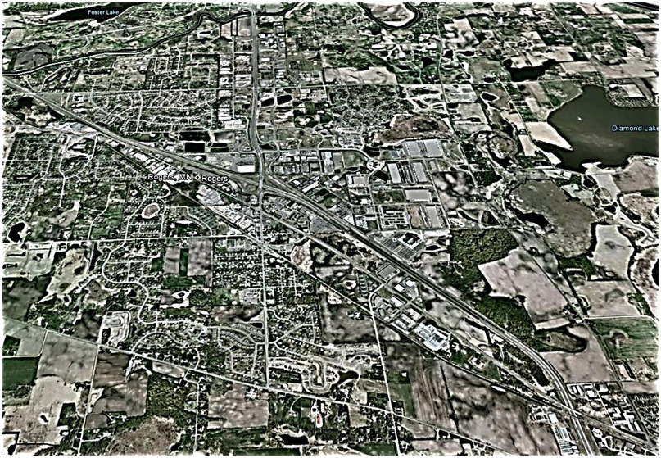

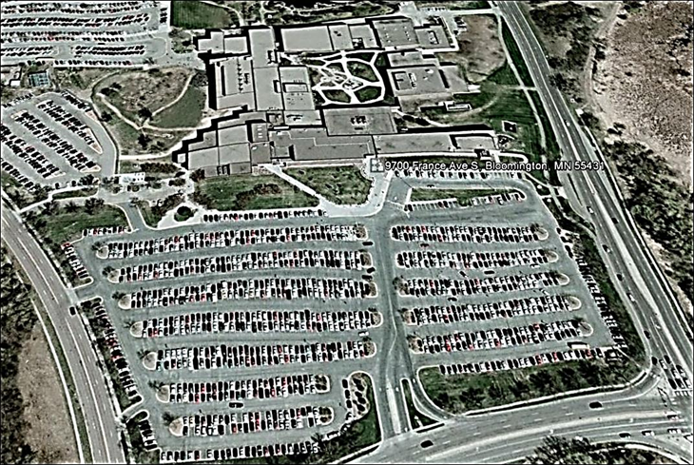
The Longitudinal and Cross Sectional Economic Impacts of Highway Interchanges
Master Thesis Proposal
Pierre Callies
Rogers, MN, Interchange I -94 and US-101
Jeff Torguson, Ph.D. – Thesis Advisor
King Banaian, Ph.D.
David Walls, Ph.D.
Saint Cloud State University
Geographic Information System Program
May 8th, 2013
Normandale Community College, Bloomington – Minnesota, South Parking Lot

Slide 2
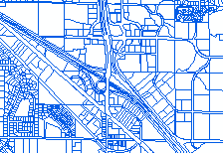
Questions
Do four-lane highway exit-ramps or interchanges generate a cross-sectional or spatial and longitudinal or temporal economic growth in areas surrounding them?
If economic Impact,
How much?
How far?
For How long?
Notes:
Do four-lane highway exit-ramps or interchanges generate a spatial and temporal economic growth in areas surrounding them? If interchanges have a local economic impact, how far does it spread from the interchange and for how long? If interchanges have a local economic impact, people and companies should be likely to migrate toward the interchange to maximize income and return on equity. Professionals would want to benefit from such economic stimuli creating a higher demand for land and properties in interchange vicinity. Commercial and industrial property market values should therefore increase faster, as a result of accrued accessibility and facilitated mobility.
After extensive publication review thereafter described, and using Interstate 94 (I-94) and MN-101 interchange, MetroGIS and Minnesota Department of Transportation data (MnDot), the purpose of this research project is to determine the existence and strength or inexistence and weakness of causal relationship between property values and their accessibility to I-94-MN-101 interchange. The property values would be the dependent variable, and its accessibility should be one independent variable with a strong weight into the regression.
.

Slide 3
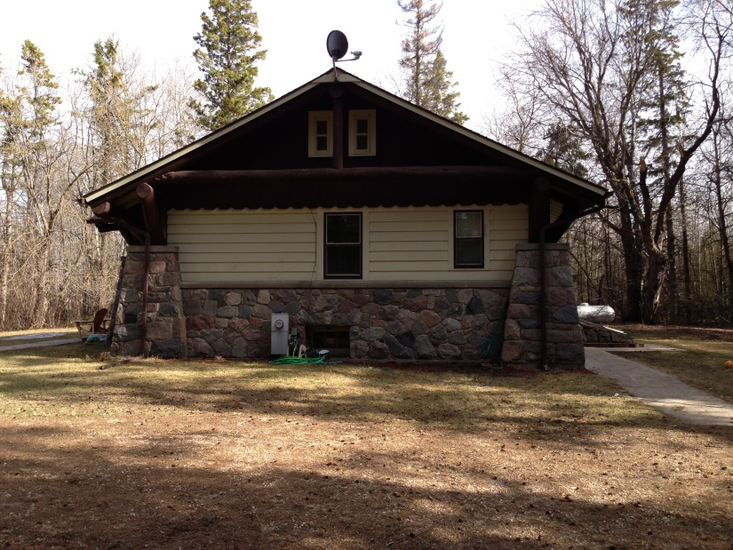
Purpose
To determine the existence and strength or inexistence and weakness of causal relationship between property values and their accessibility to I-94-MN-101 interchange.
The property values would be the dependent variable, and its accessibility should be one independent variable with a strong weight into the regression
Notes:
Do four-lane highway exit-ramps or interchanges generate a spatial and temporal economic growth in areas surrounding them? If interchanges have a local economic impact, how far does it spread from the interchange and for how long? If interchanges have a local economic impact, people and companies should be likely to migrate toward the interchange to maximize income and return on equity. Professionals would want to benefit from such economic stimuli creating a higher demand for land and properties in interchange vicinity. Commercial and industrial property market values should therefore increase faster, as a result of accrued accessibility and facilitated mobility.
After extensive publication review thereafter described, and using Interstate 94 (I-94) and MN-101 interchange, MetroGIS and Minnesota Department of Transportation data (MnDot), the purpose of this research project is to determine the existence and strength or inexistence and weakness of causal relationship between property values and their accessibility to I-94-MN-101 interchange. The property values would be the dependent variable, and its accessibility should be one independent variable with a strong weight into the regression.
.

Slide 4
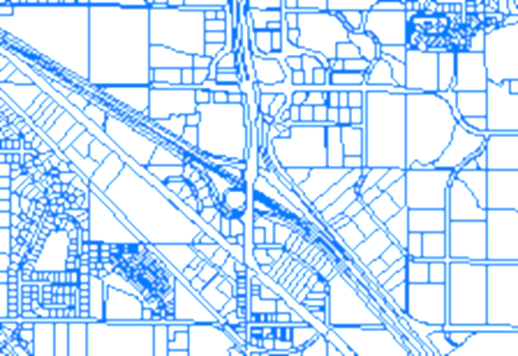
If / If Not?
IF Causal Relationships
Similar Pattern
Consistent Pattern
Area Dependent Growth
For
Residential, & Commercial
Property Value
IF No Causal Relationships
Uniform Pattern for all
Growth
Value
For Residential and Commercial
Property Value
Notes:
.
On one hand, if a strong causal relationship exists, the property value evolution should be very consistent for residential and commercial properties and follow similar patterns around the interchange. In other words, the property-value-growth rate for residential properties should be maximal in certain areas around the interchange. Similarly, property-value-growth rate for commercial properties should be maximal in other areas. The optimal property-value-growth rates should be proportional or inversely proportional to their accessibility or Manhattan distance to/from the interchange.
On the other hand, if no strong causal relationship exists, the property value evolution should be similar across the region regardless of their accessibility from the Interchange, and the discrepancies between property values should be explained by sampling error only. Thus, our research should answer the question: Are the most expensive property growth values, the closest from an interchange, or along the four-lane highway for each groups that encompass commercial, manufacturing, and residential properties.

Slide 5
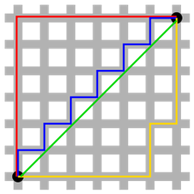
Methodology
Concepts
MetroGIS Databases
Property Values
MnDot Databases (Minnesota Department of Transportation)
Traffic Flow Sensor
Road Characteristics
The time adjusted true value distance as the Manhattan physical distance between two points that is weighted by the number of road blocks such as stop lights and signs, speed limits, congestions, and other restrictions that impair the mobility of commuters and accessibility of sites .
Notes:
The methodology used to determine the predictability of property value from their distance of the interchange first consists in weighting property value data provided by MetroGIS with related accessibility data provided my MnDot.
MetroGIS provides descriptive information about commercial and residential properties with related geographical coordinated.
MnDot provides information about traffic flows and road conditions. Dividing the distance of the most logical accessibility path between properties and the interchange with the time required to cover such a distance, should provide the “true” distance between the two points. The time adjusted true distance should consequently become a factor in predicting the value of properties especially when comparing them in a longitudinal way.
We define the time adjusted true value distance as the Manhattan physical distance between two points that is weighted by the number of road blocks such as stop lights and signs, speed limits, congestions, and other restrictions that impair the mobility of commuters and accessibility of sites (appendix 1).

Slide 6
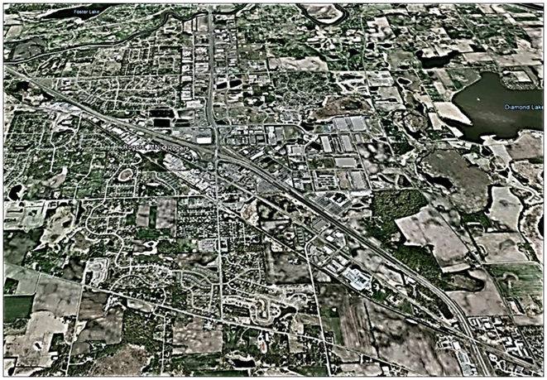
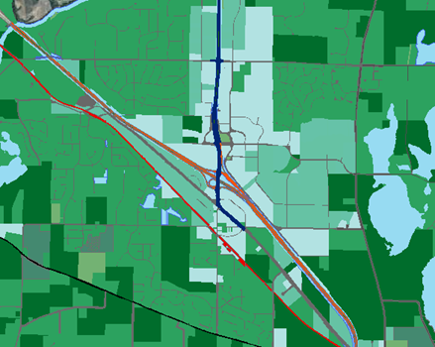
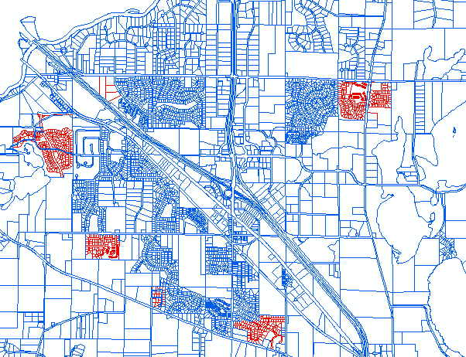
Tools
Rogers, Minnesota
Source Google Earth
Photography
Source Pierre Callies
Land Use
Interstate 94 and MN 101
Interchange
Source MetroGIS
Property Identification and Changes
Notes:
Mapping the longitudinal, cross sectional and residual values should provide systematic concentrations of similar properties at specific distance from the interchange. If the null hypothesis holds, the closer the property from the interchange and the greater its market values evolution would be. In other words, the location of optimal property value growth rates should coincide with the location of the interchange. If the alternate hypothesis holds, property value growth rates should be uniform all over the market without concentration around the interchange, and could be explained by sampling statistical error only.

Slide 7
Parsimonious and Expended Specifications
Goodman and Thibodeau
Disaggregation increases the prediction accuracy of hedonic house price estimates and that the procedure used to construct housing submarket can contribute to the efficiency of resulting market value predictions . (Goodman and Thibodeau 2003)

Slide 8
Brigham 1965
If transportation were instantaneous and costless, then the urban population could spread out over all usable and all land price would be reduced to their approximate value in the best alternative use. But transportation is not instantaneous and costless, and since modern life requires the concentration of people in cities, urban land takes on a special accessibility value.
Notes:
If transportation were instantaneous and costless, then the urban population could spread out over all usable and all land price would be reduced to their approximate value in the best alternative use. But transportation is not instantaneous and costless, and since modern life requires the concentration of people in cities, urban land takes on a special accessibility value (Brigham 1965, P 226).
In other words, there is an intimate and reciprocal relationship between land accessibility and people’s mobility in the determination of property values. This article reviews should therefore focus on some fundamental determinants of residential and commercial land values, on the hedonic housing and commercial market segmentation prediction accuracy, and on the interdependency of accessibility and mobility among sites in the supply and demand equilibration of market equilibrium to determine the city of Rogers, MM interchange selection criteria.

Slide 9
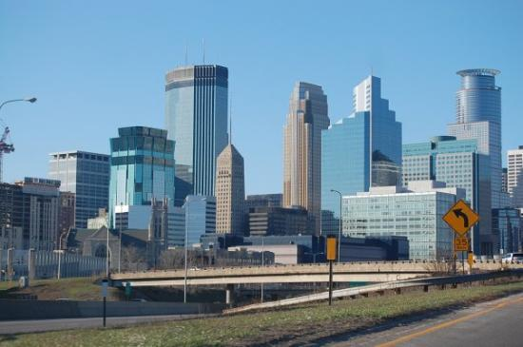
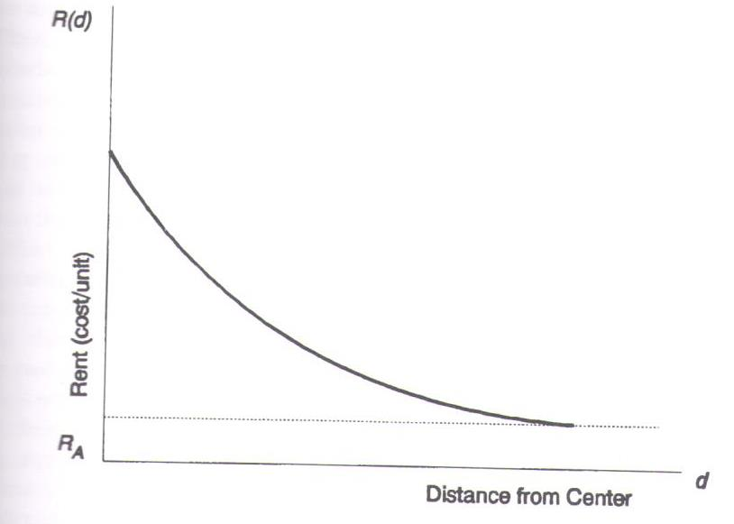
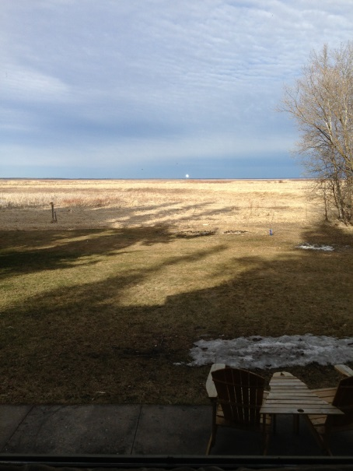
Land Prices
Goodman and Thibodeau
Land price is proportional to lend rent, and the price of land at the boundary of an urban area equals the value of Agricultural Land.

Slide 10
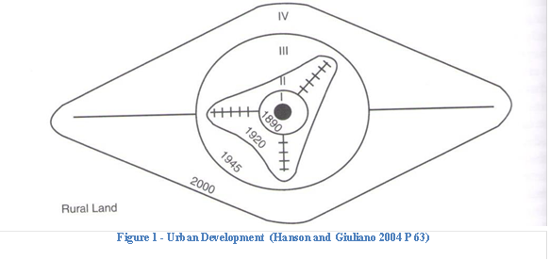
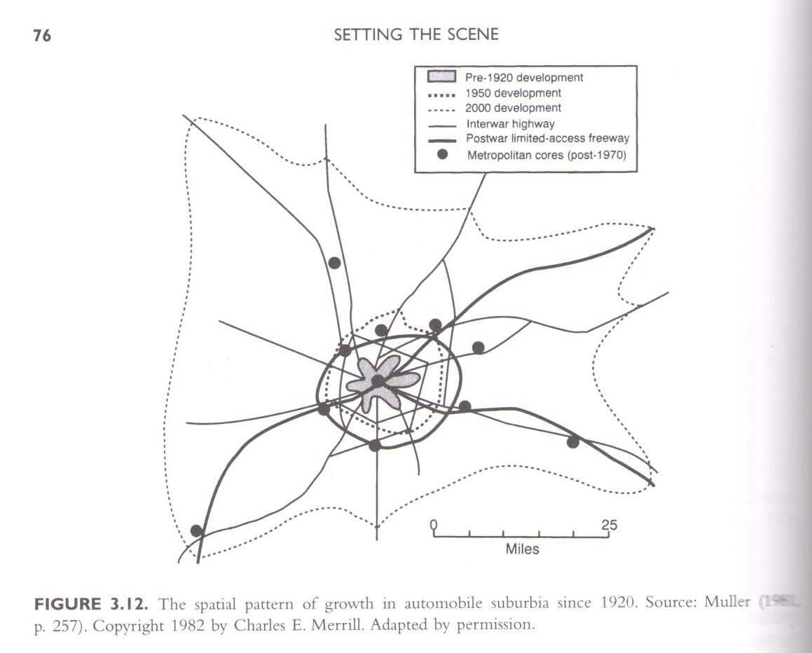
Hanson & Giuliano
Hanson and Giuliano describe it:
Walking-Horsecars era (1800-1890)
Electric Street Car era (1890-1920).
Recreational Automobile Era (1920-1945).
freeway era (1945-present)
Notes:
Historically, there is an important interdependency between land development, mobility and accessibility, and economic development. Susan Hanson and Genevieve Giuliano (2004 P63) identify four historical periods in intraurban transport: the walking horse car Era, the Electric Street Car Era, the Recreational Auto Era, and the Freeway Era. Each era increased either the accessibility or the mobility or both by modifying the distance travelable between the residential areas and center business districts. Each era modified the geographical shape of urban area as mobility and accessibility increased creating a huge time convergence between origin and destination of any trips.(Hanson and Giuliano 2004 P330) (Adam 1979 P28). As Hanson and Giuliano describe it:
During the Walking-Horsecars era (1800-1890) commuters only have their feet and horsecars to move around. Everything had to be close to one another as the mobility was extremely reduced.
During the Electric Street Car era (1890-1920) commuters’ mobility is increased by the speed of electrical street car and rail road steam engines. They can cover more distance in the same period of time, so that cities begin to spread out along street car path. Because commuters still have to walk between home and the street car stop stations, they reside along the paths of electrical street car and rail road track.
During the Recreational Automobile Era (1920-1945) commuters gain mobility as automobiles are not limited by the tracks of electrical street cars and rail road tracks. Commuters can complete door-to-door commutes between origins and destinations. Areas previously undeveloped are filed up with new residential construction, as the automobile increased accessibility to remote land, and mobility.
During the freeway era (1945-present) commuters gain accessibility by providing high speed intraurban networks. Commuters can cover greater distance in the same amount of times. Freeways become “main streets.” Urban areas expend along freeway creating urban sprawling.
In other words, modern commute is predetermined by the strength of accessibility and mobility to both central business districts and the strength of accessibility predetermine the demand for lands (Brigham 1965). Anthony Chen, Plya Chootinan, Seungkyu Ryu, and S.C. Wong, who reviewed recently developed measure for assessing the quality of origin destination estimated from traffic count, conclude that new generalized demand scale measures still have limited applications as so many parameters are unspecified. Yet, they recognize the value of traffic modelization in estimating the demand for land.
Using ArcView Network Analyst, Mohamad Abdel Aty and Yile Huang showed that the distance traveled to access or after exiting a ramp does not depend only on the spacing between ramps, but on several factors, such as trip purpose, vehicle occupancy, driver’s income level, and E-Pass use (Abdel-Aty and Huang 2004). In most cases, they demonstrated that the systems optimized route is the best route with the shortest travel time. That is, we need to dissociate the demand for land, and resulting price in accordance to the types of properties (residential, commercial, industrial) on one hand. On the other hand, each type of properties shall be divided by the type of usage (Single home, condominium, rental) and by type of income.

Slide 11
Time-Space-Cost Convergences
Dong, Zhang, Nagurney
if the price that a retailer is willing to pay for the product is precisely equal to the manufacturer’s marginal production and transaction cost associated with that retailer. On the other hand if the manufacturer’s marginal production and transaction cost exceeds what the retailer is willing to pay for the product, then there will be zero shipment of the product between the pair.
(Dong, Zhang, and Nagurney 2004 P196)
Notes:
Finally, June Dong, Ding Zhang, and Anna Nagurney investigated supply chain network equilibrium models with and with our random demands, which support the notion of time convergence and divergence. That is, the optimal conditions predetermined by some statistical variational inequality states that if the price that a retailer is willing to pay for the product is precisely equal to the manufacturer’s marginal production and transaction cost associated with that retailer. On the other hand if the manufacturer’s marginal production and transaction cost exceeds what the retailer is willing to pay for the product, then there will be zero shipment of the product between the pair (Dong, Zhang, and Nagurney 2004 P196).
They further argue that human being can be compared to product when commuting. That is, people generally limit their commute to 45 minutes between home and work (Hanson and Giuliano 2004 P 210), That is, the distance covered in 45 minutes is proportional to the average speed and inversely proportional to road blocks and energy cost. In other words, the faster vehicles can circulate; the less congestion, street lights, right angle turn; and the lowest the cost of gas, the greater the commuted distance. Inversely, if any of the conditions above are changed, the smaller the commuted distance. Effective and efficient transportation network induces commutes who may result in greater economic growth. Thus, in the past, once farm lands were transformed or more precisely prepared for development, the urban limits moved further away as wealthier people had more opportunities to find residential area away from crowed urban city (Capozza and Helshley 1989 P 302).
Today, medium and lower income residents also seek to reside at the limits of rural and urban area as the cost of housing is often cheaper than in major urban concentration. Workers are utility and revenue maximizing economic agents. That is they want the best they can have within the limits of their revenues. Thus, people will allocate monies and time budgets for everything from work to leisure, and find the superior allocation for each budget. So, if the cost of housing is too expensive in an area of town, people might seek alternate housing in cheaper area, though commute costs in time and monies might be greater. Similarly, in the early 2000, when the cost of gas was around US$0.80 a gallon, people used to purchase SUVs and powerful pickup trucks. As soon as cost of gas raised in 2004, and especially after 2005 hurricane Catherina, Gas Guzzling SUVs and pickup trucks piled up on every driveways between Minneapolis and Detroit Lakes with signs “for sale” on them: a clear indication that people were trying to keep their standard of living by reducing the energy cost of transportation.

Slide 12
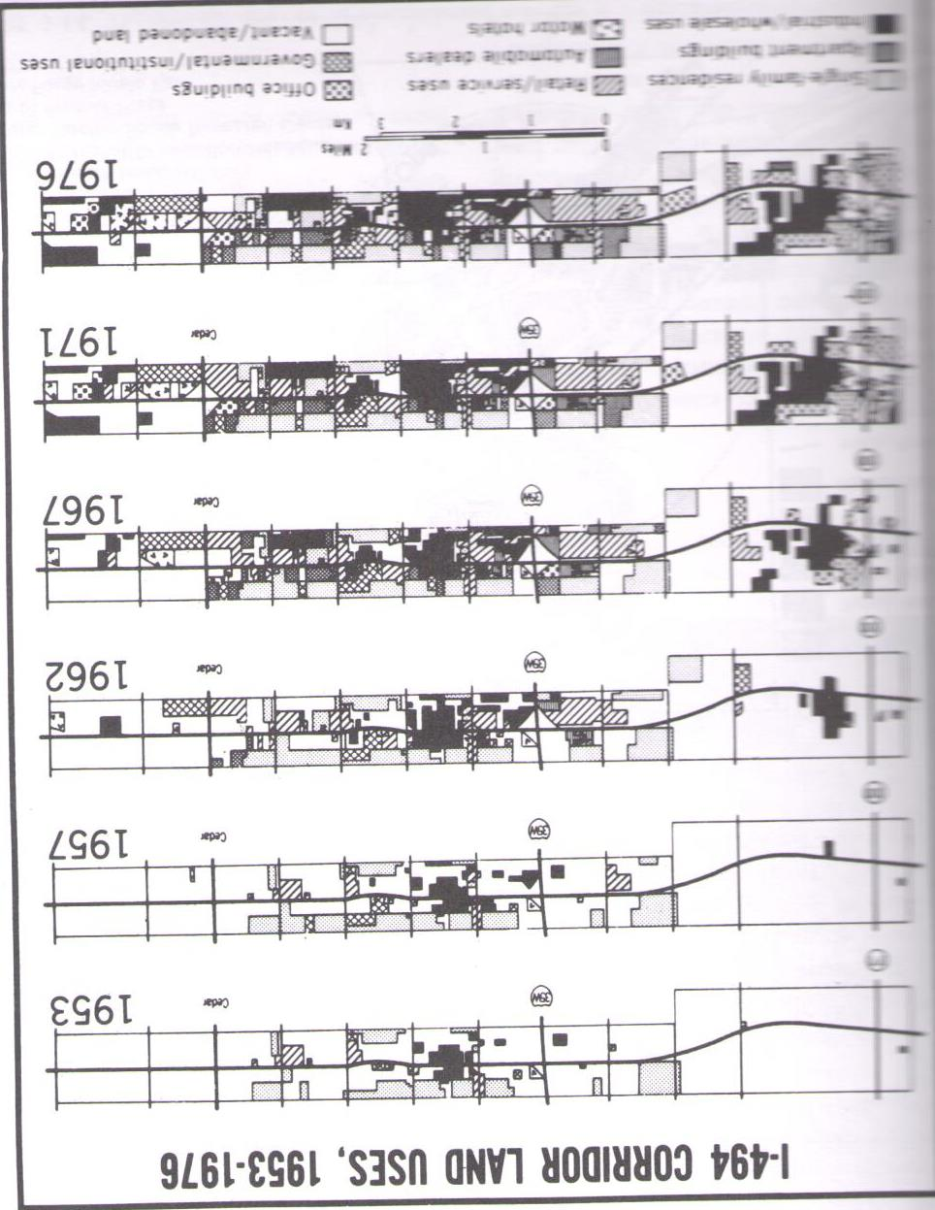
Time-Space-Cost Convergences
Hanson and Giuliano
45 Minutes Time Limits One Way
Work
Home
Day caring, Shopping, Schooling, + ???
Distance Covered Proportional to
Mobility Speed Limits
Accessibility
Wealth
Economic Vitality
Distance Covered Inversely Proportional to
Energy Costs
Traffic Jams
Road Blocks
Induced Congestions
Parking Restrictions
Notes:
Finally, June Dong, Ding Zhang, and Anna Nagurney investigated supply chain network equilibrium models with and with our random demands, which support the notion of time convergence and divergence. That is, the optimal conditions predetermined by some statistical variational inequality states that if the price that a retailer is willing to pay for the product is precisely equal to the manufacturer’s marginal production and transaction cost associated with that retailer. On the other hand if the manufacturer’s marginal production and transaction cost exceeds what the retailer is willing to pay for the product, then there will be zero shipment of the product between the pair (Dong, Zhang, and Nagurney 2004 P196).
They further argue that human being can be compared to product when commuting. That is, people generally limit their commute to 45 minutes between home and work (Hanson and Giuliano 2004 P 210), That is, the distance covered in 45 minutes is proportional to the average speed and inversely proportional to road blocks and energy cost. In other words, the faster vehicles can circulate; the less congestion, street lights, right angle turn; and the lowest the cost of gas, the greater the commuted distance. Inversely, if any of the conditions above are changed, the smaller the commuted distance. Effective and efficient transportation network induces commutes who may result in greater economic growth. Thus, in the past, once farm lands were transformed or more precisely prepared for development, the urban limits moved further away as wealthier people had more opportunities to find residential area away from crowed urban city (Capozza and Helshley 1989 P 302).
Today, medium and lower income residents also seek to reside at the limits of rural and urban area as the cost of housing is often cheaper than in major urban concentration. Workers are utility and revenue maximizing economic agents. That is they want the best they can have within the limits of their revenues. Thus, people will allocate monies and time budgets for everything from work to leisure, and find the superior allocation for each budget. So, if the cost of housing is too expensive in an area of town, people might seek alternate housing in cheaper area, though commute costs in time and monies might be greater. Similarly, in the early 2000, when the cost of gas was around US$0.80 a gallon, people used to purchase SUVs and powerful pickup trucks. As soon as cost of gas raised in 2004, and especially after 2005 hurricane Catherina, Gas Guzzling SUVs and pickup trucks piled up on every driveways between Minneapolis and Detroit Lakes with signs “for sale” on them: a clear indication that people were trying to keep their standard of living by reducing the energy cost of transportation.

Slide 13
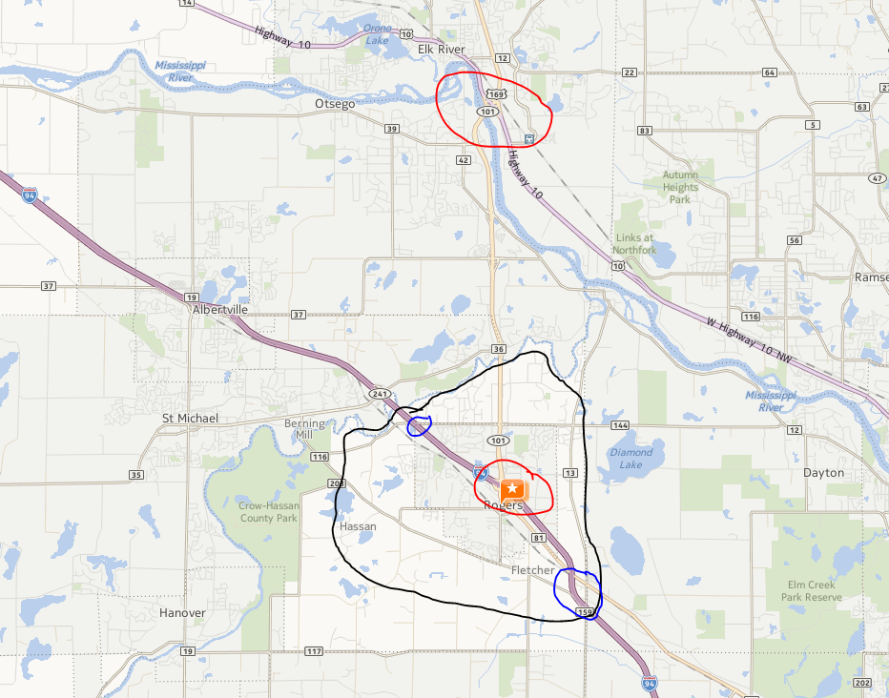
Why Rogers, MN
45 Minutes from
St Cloud
Most Twin Cities Locations
Natural Barriers
Crow River
Mississippi
Two Access Points
I 94
US 10
Diverse Accessibility
North
South
Four distinct Areas
Limited by 101 and 94
Two Potential Access Points
Figure 2 - Rogers Minnesota – Black: Area Of interest – Red: Access Points – Blue: Potential Access Points
Notes:
The city of Rogers, Minnesota, provides a unique environment to assess the validity of economic impact of four-lane-highway exit ramps or interchange. Forty years ago, Rogers was a rural environment. Over the years, the interchange between I-94- MN-101 was developed, and the rural land rapidly transformed into an urban area. As of 2013, Rogers has the following characteristics:
Figure 2 - Rogers Minnesota – Black: Area Of interest – Red: Access Points – Blue: Potential Access Points
Market segmentation shows that the area south of I-94 is not as evenly developed than the north (Goodman and Thibodeau 2003). On the north side of I-94, MN-101 is a fast four lane freeway, whereas on the south side of I-94, MN-101 is a narrow one lane street crossing through the old Rogers downtown. Rogers is also surrounded by natural barriers such as the Crow and Mississippi Rivers, so that commuters only have two major exits from their neighborhood to access either I-94 or US-10 in the north making it easier to estimate commuters’ path.
Yahoo and Google maps itinerary makers demonstrate that any sites from Saint Cloud to the south Eastern side of the Twin City Metro (Inver Grove Height) is within 45 Minutes from Rogers using any of the freeways.
On I-94, there are two bridges with no access ramps. These bridges would be our control sites, as we expect land around to be very expensive as it would take minimum work and money to upgrade the network. Hence providing rapid expansion of commercial lands around the two bridges, and residential construction in lands south of Rogers downtown as a road could rapidly be transformed into a four lane freeway to facilitate access and mobility.
Recently, BusinessWeek cited Rogers as the best city to raise children in the nation.
We are hoping to determine that the property values distribution around I-94 coincides with the locations of interchanges for each of the categories. We should find different of areas for residential and commercial properties. For residential single dwelling, we expect expensive properties to be in “quieter” areas, and apartment building closer to the freeway.

Slide 14
Rogers, Minnesota
Well?
4,833 Observations
69 Fields

Slide 15
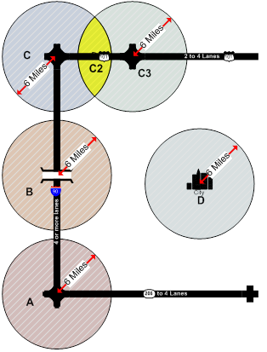
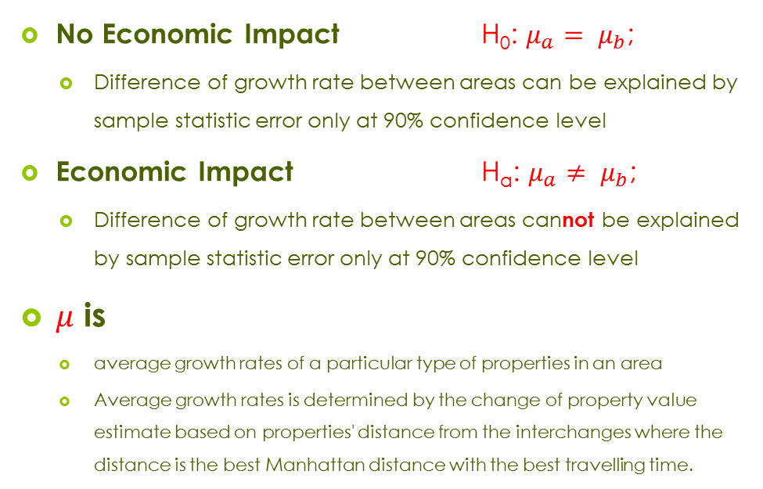
Summary
Definition
No Economic Impact H₀: $μ_{a}= μ_{b}$;
Difference of growth rate between areas can be explained by sample statistic error only at 90% confidence level
Economic Impact H_{a}: $μ_{a}≠ μ_{b}$;
Difference of growth rate between areas cannot be explained by sample statistic error only at 90% confidence level
$μ$ is
average growth rates of a particular type of properties in an area
Average growth rates is determined by the change of property value estimate based on properties' distance from the interchanges where the distance is the best Manhattan distance with the best travelling time.
Notes:
There are thousands of articles dealing with geo-economics and in particular the relationship between spatial economic growth and network quality.

Slide 16
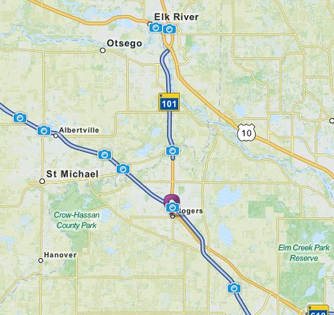
Summary
Methodology
Regression
Spatial Analysis
Time Series Analysis
Hot Spot Analysis
Overlapping Network and Hot Spot Maps

Slide 17
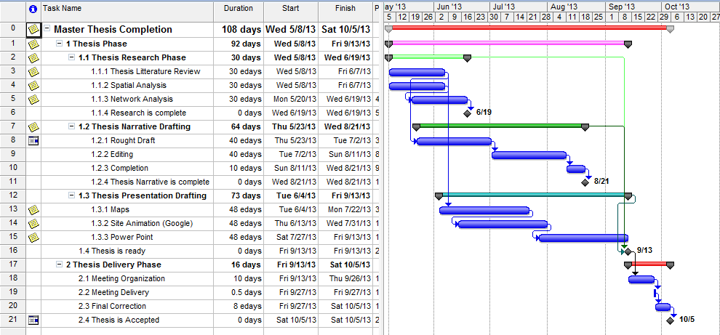
Time Line
Notes:
In order to develop such research, I am proposing to laydown the following research path.
The proposal should review the historical and personal background that lead me to such project. It should also attempt to explain the reasons of such research. It should research existing literature to define research scopes and parameters. It should provides a formal definition of the research plan. It should propose research methodology with estimated deliverables. It should finally estimate some of the findings.

Slide 18
Most Likely
Findings
Most Expensive Residential Lands Away from 94 and 101
Most Expensive Agricultural Lands Around Potential Access Ramps Development
Different Property Values Based on Accessibility
Moderate Causality but Strong Correlation

